Slide 1
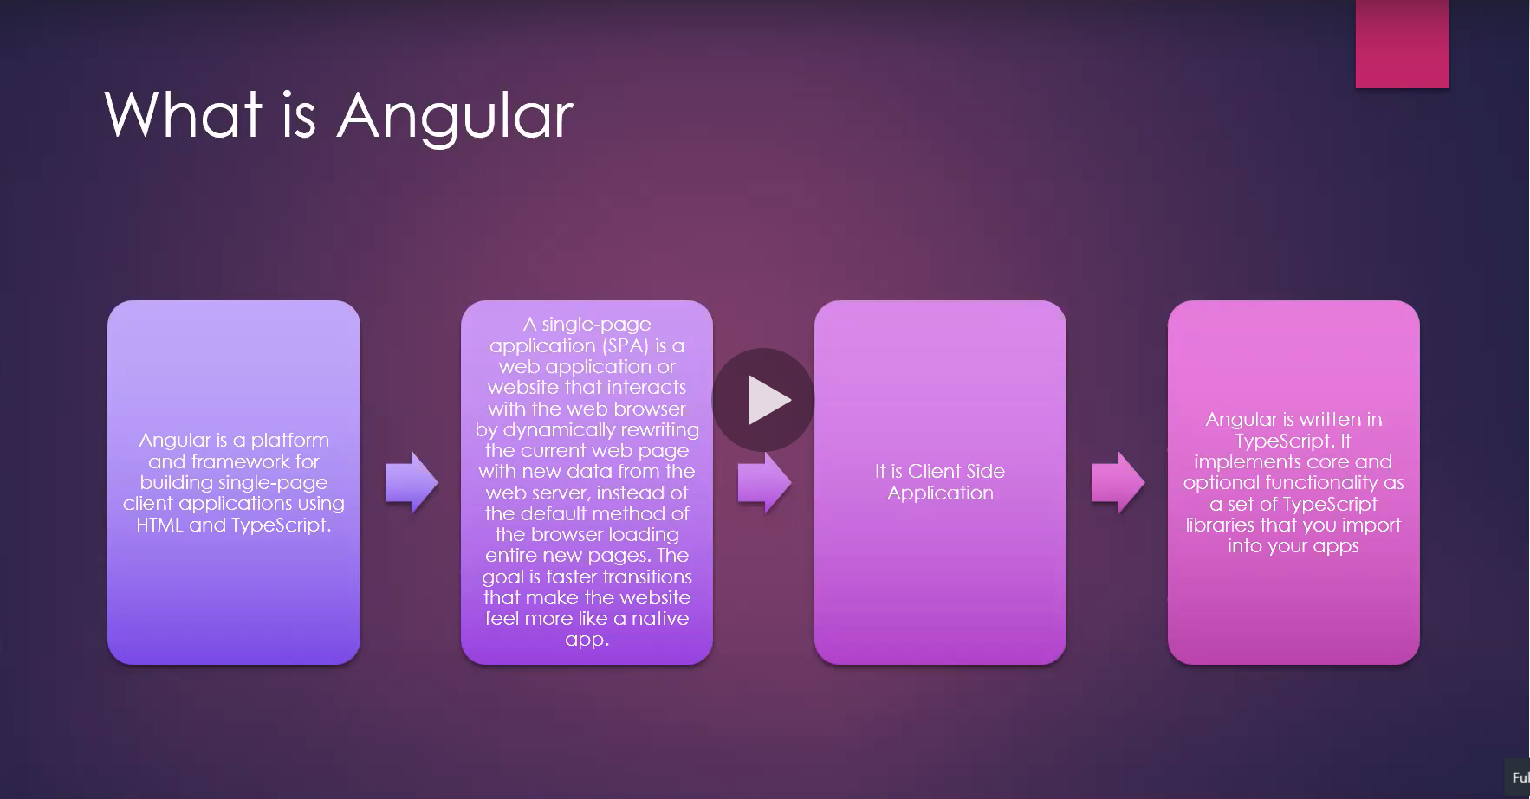

Slide 2
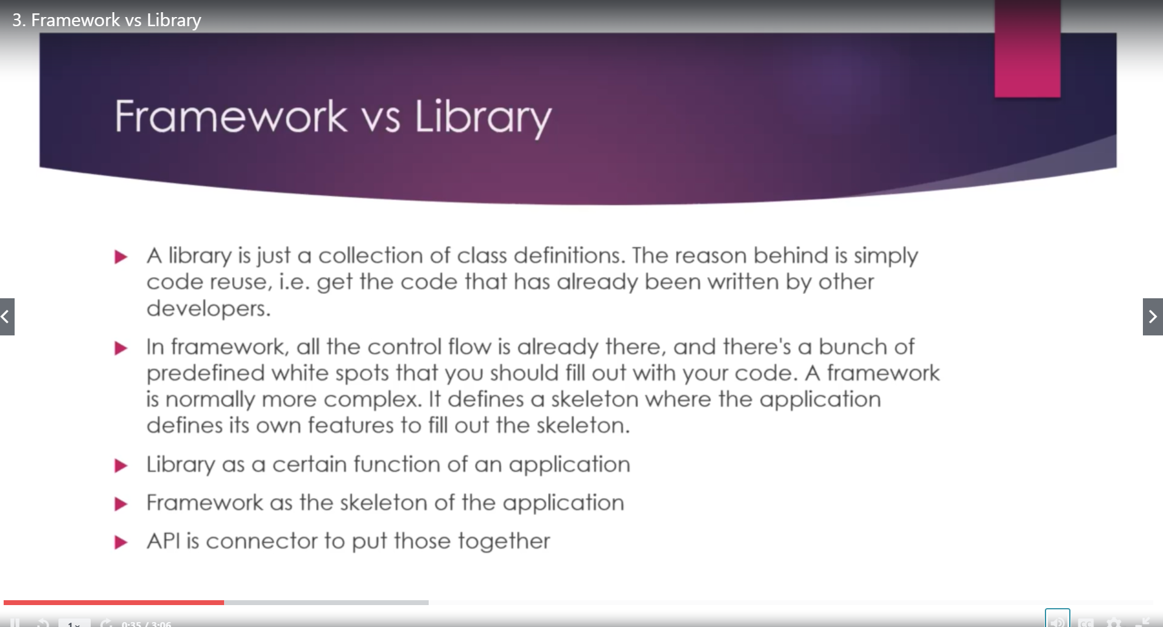

Slide 3
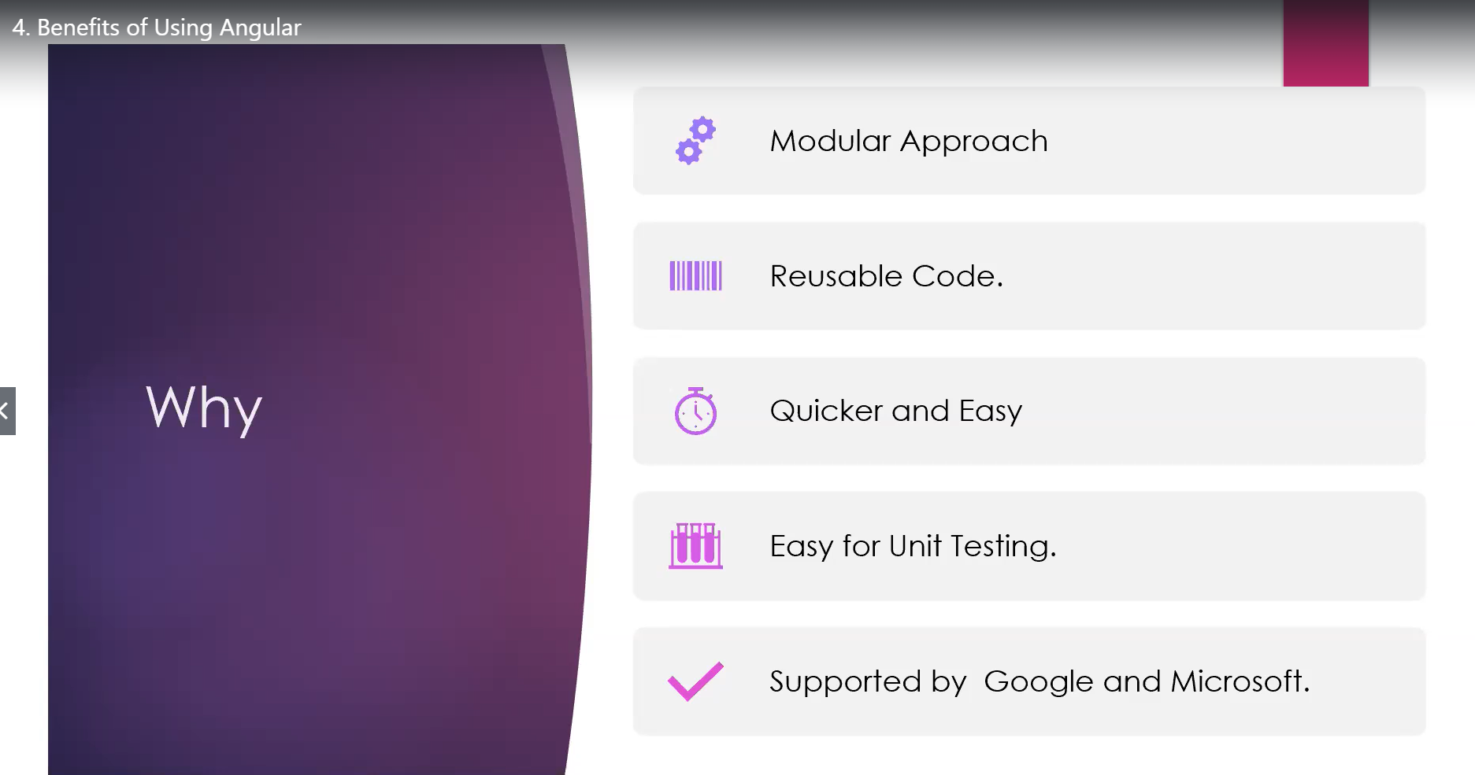

Slide 4
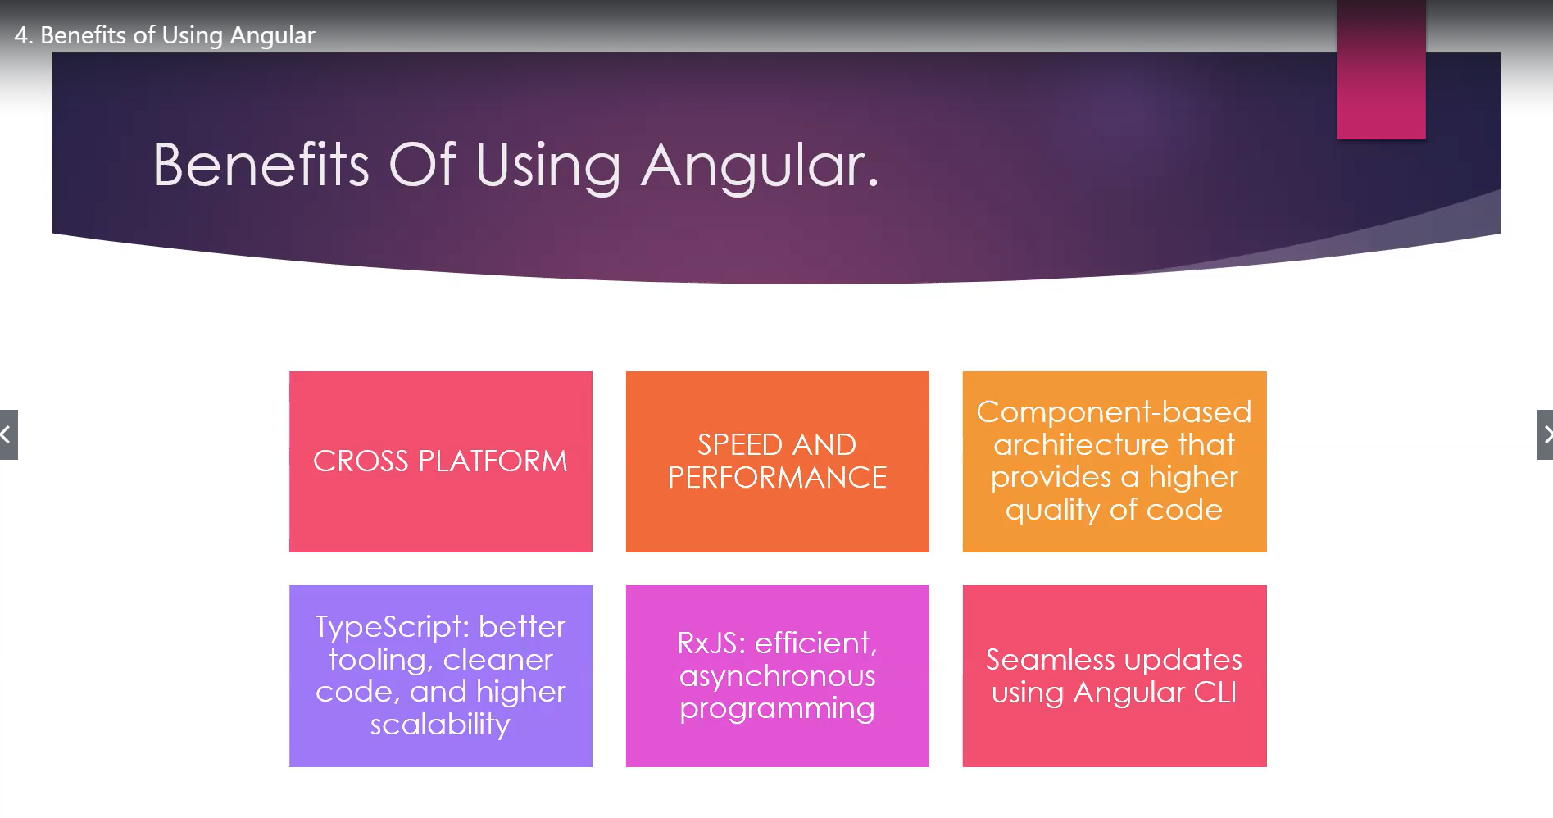

Slide 5
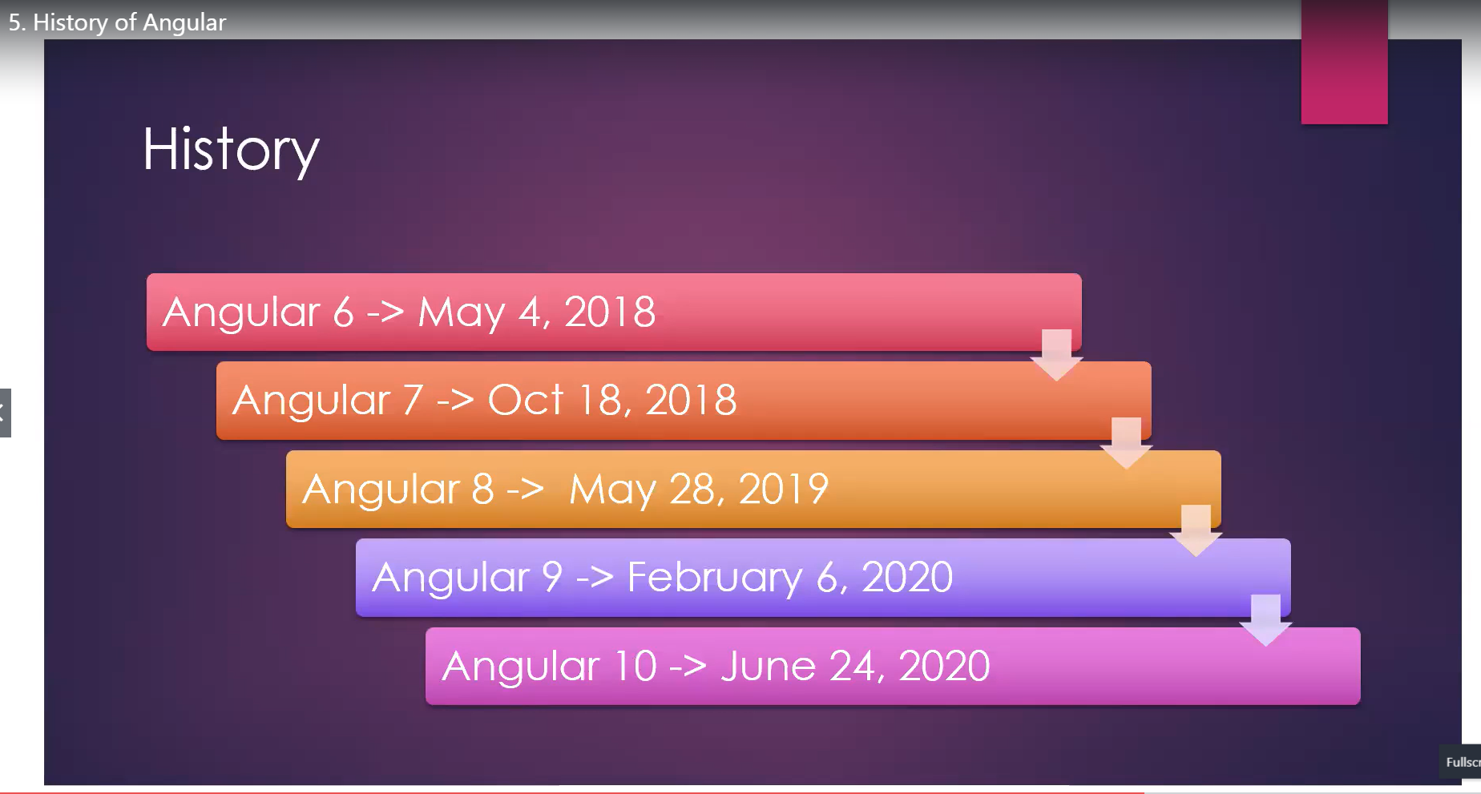

Slide 6
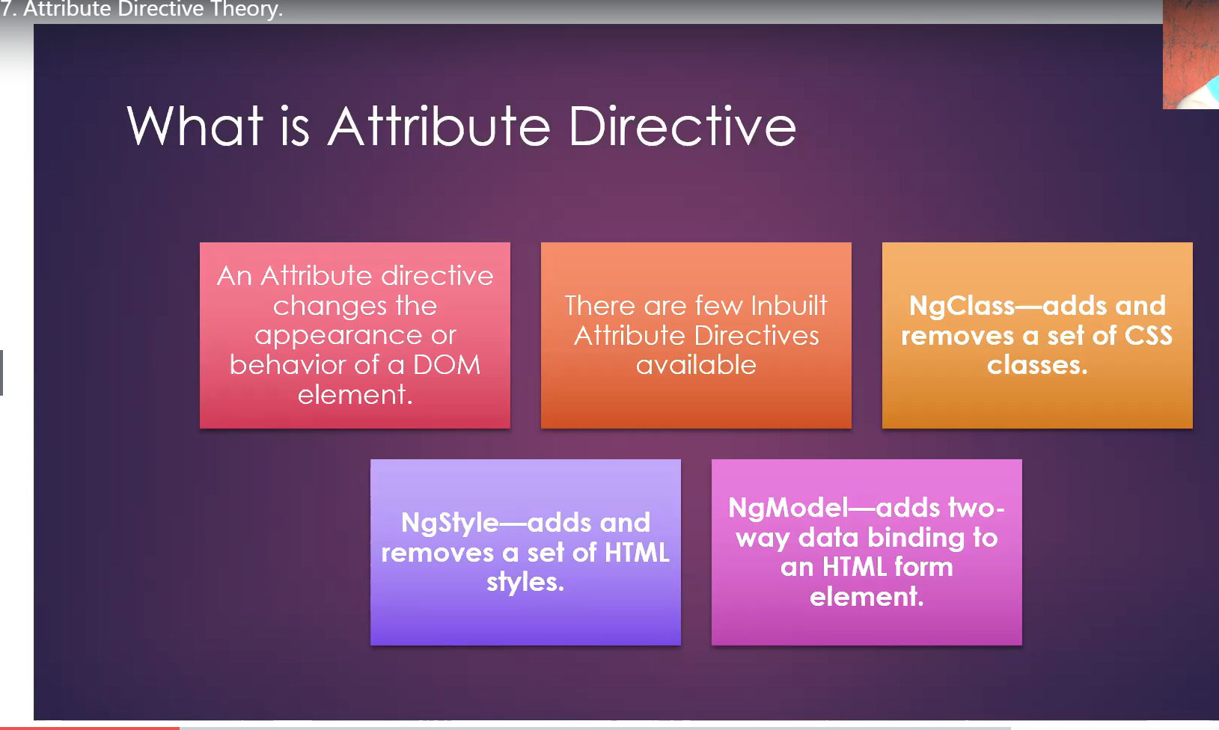

Slide 7
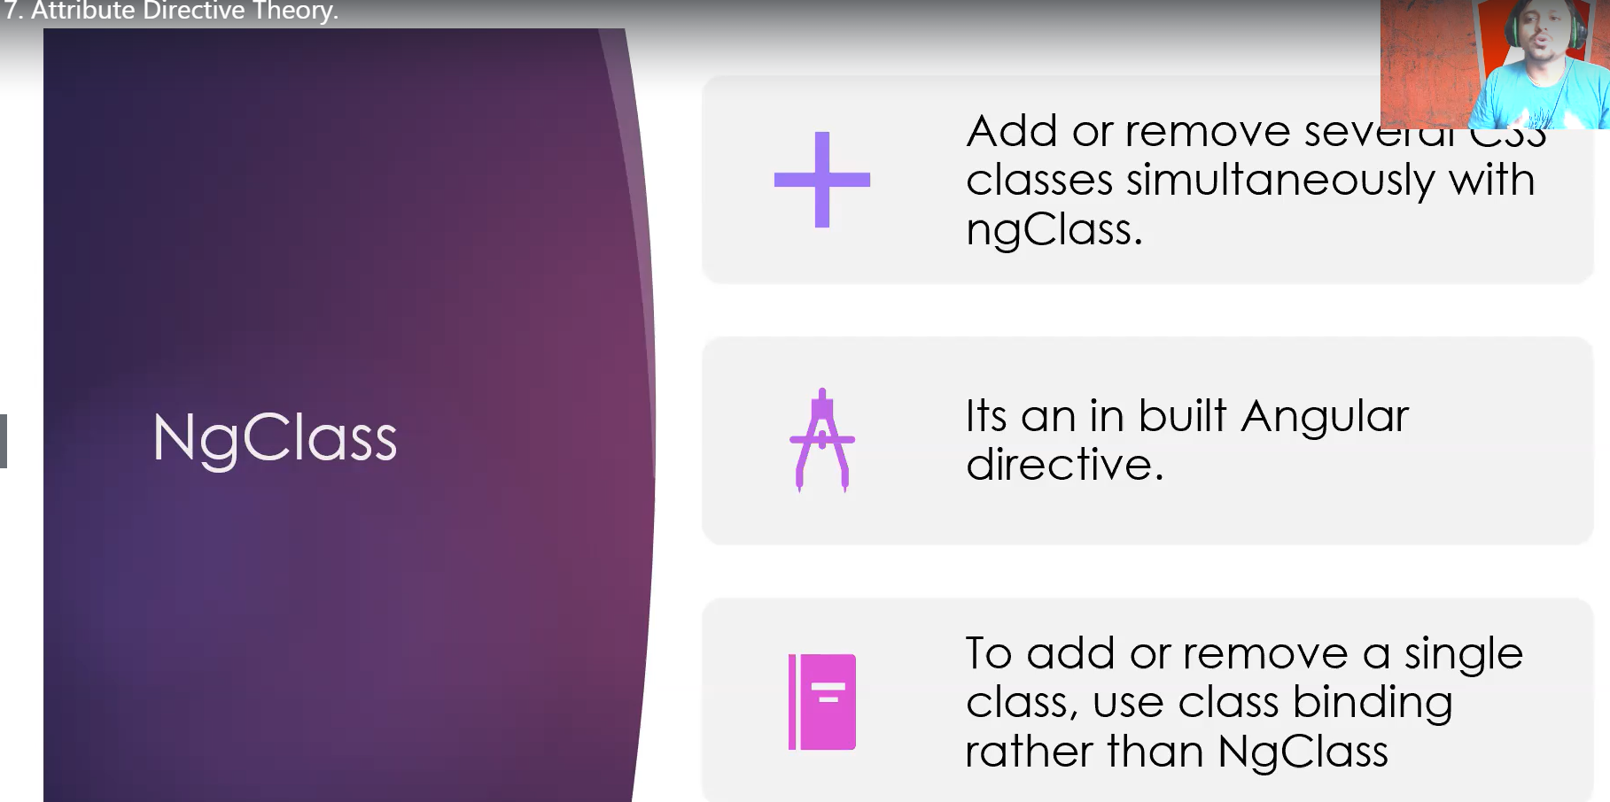

Slide 8
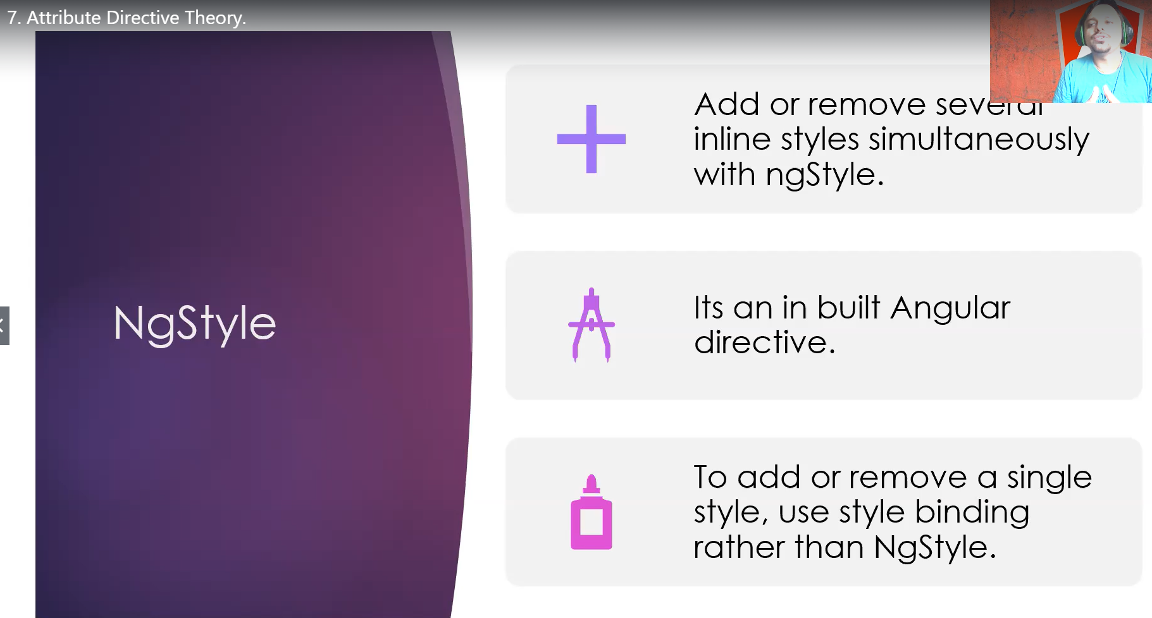

Slide 9
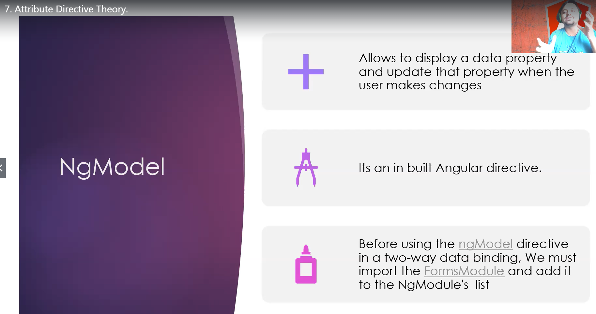

Slide 10
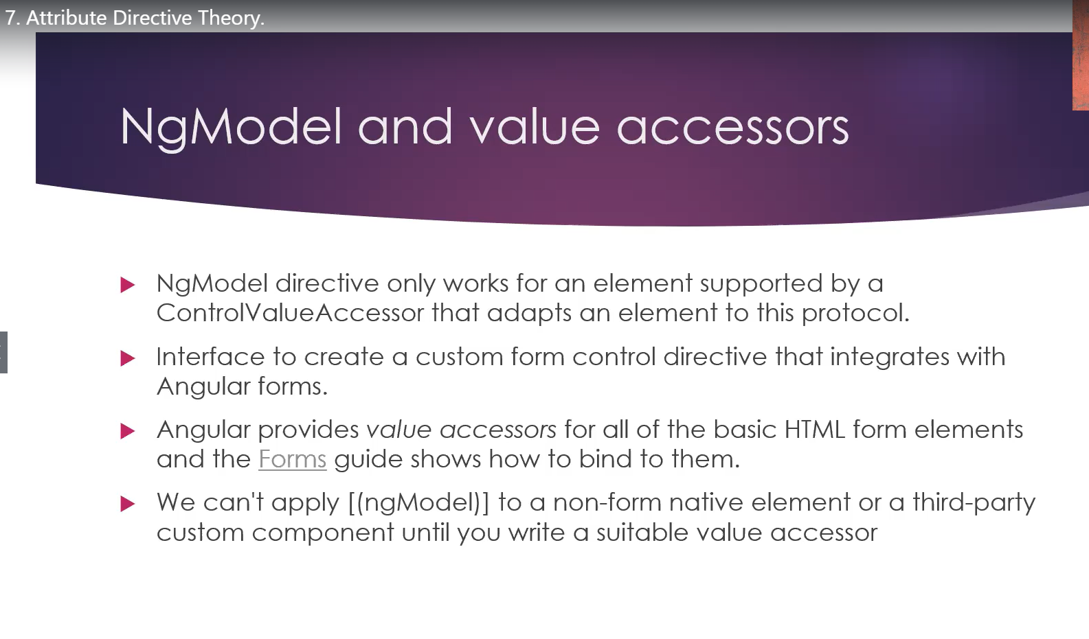

Slide 11
To install the angular CLI, first we need to install the nodejs
Hence to go to Nodejs.org and install node js
After nodejs install run the following command to install angular CLI
npm install –g @angular/cli or npm install –g @angular/cli@latest
To check the version of angular ng --version
To start the first project write the following command ng new my-first-app
After create the first app to run ng serve
We can create component using many methods like
We create manually component
We creare with cli command
ng g c {componentname} >> ng g c property-card
Right click on the respective folder and then click create component

Slide 12
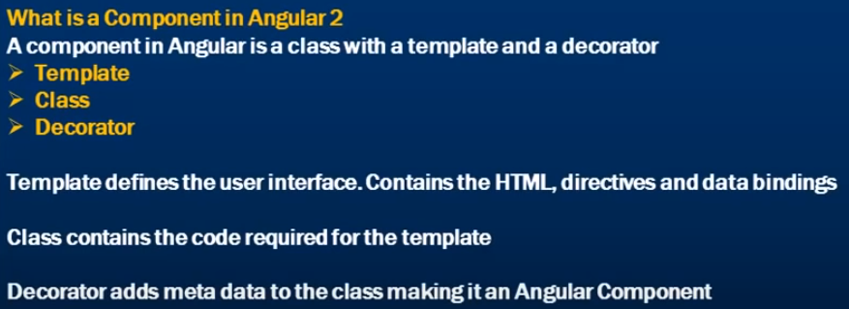
Everything in angular is component, i.e. component is a basic building block to build angular application.
A component in angular is composed of these three things: Template, Class and Decorator
Please check Doc notes have written more about angular 2 components.
Component Decorator contain the meta data of the following class, this meta data contain
Htmlurl and class
App module is root module, in app module we import ng module, this mdule provide ngif and ngfor directives
Ngmodule is required to add meta data to an angular module
Remember the compoenent decorator add meta data to angular compenent in similar fashion
The ngmodule add meta to an agular module

Slide 13
AppModule the application root module
Every Angular app has a root module class. By convention, the root module class is called AppModule and it exists in
a file named app.module.ts AppModule is the root module which bootstraps and launches the angular application.
You can name it anything you want, but by convention it is named AppModule
If you don’t register your component in the app.module.ts file and try to use it in the other components,
then you won’t get the output and console will show the following error

Slide 14
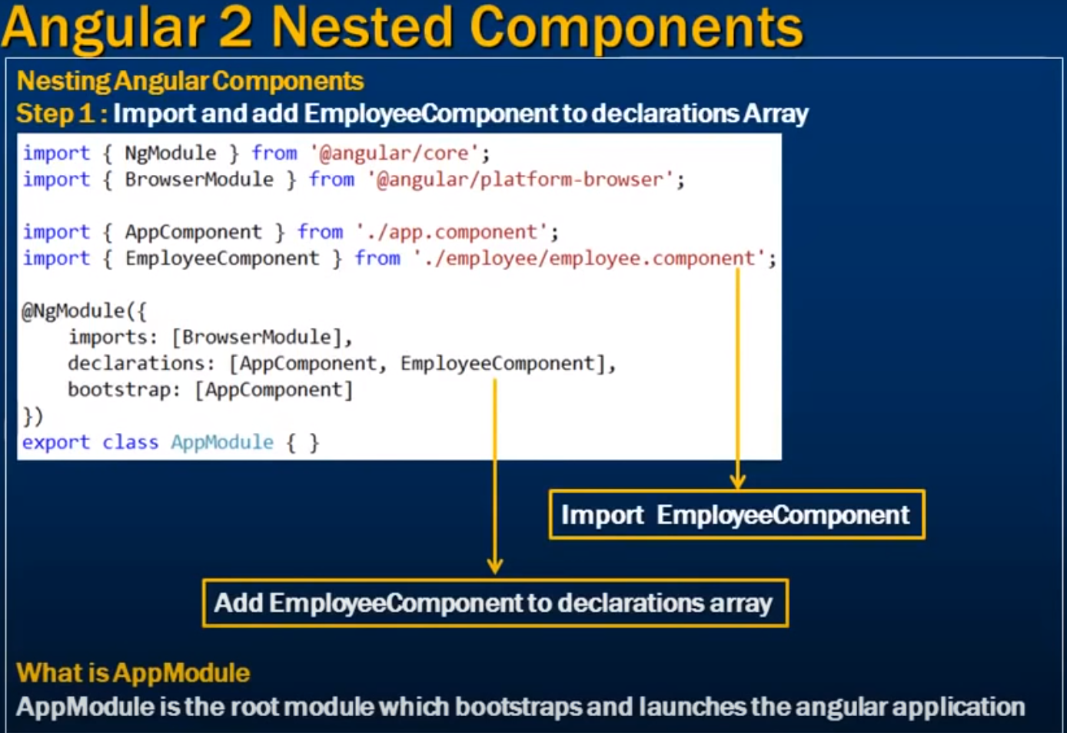

Slide 15
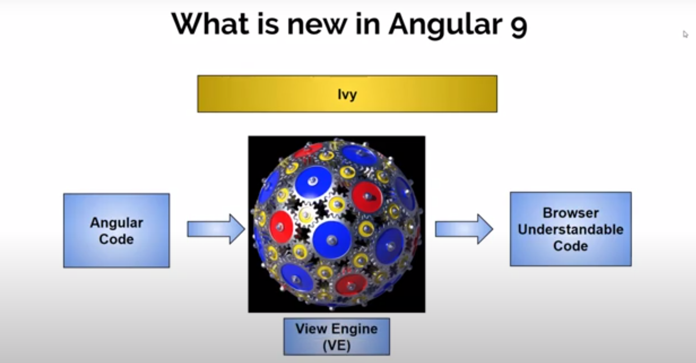
In Angular the compiler was used view engine, but from angular 9 the default compiler is Ivy. Angular 9 application is smaller in size after compiled and much fast.
Other improvements are
-You tube player
-Google Maps
-Type Script 3.7 Support

Slide 16
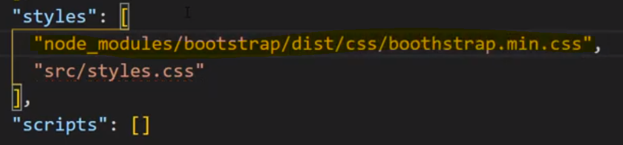
Install some important extension for angular in VS code.
Angular Snippet
Angular Rename Tag
Bracket Pair Colorizer 2
Angular Files
Intellisense for css class names in HTML
TypeScript is the superset of Javascript. At the end Type Script convert to Java script after compile and this process is called Transpile
To install the Bot strap use the following command while in angular
Npm install bootstrap - -save
--save actually will create a reference of bootstrap in your package.json file
Also add reference of bootstrap in the styles of angular.json file, as shown in the figure

Slide 17
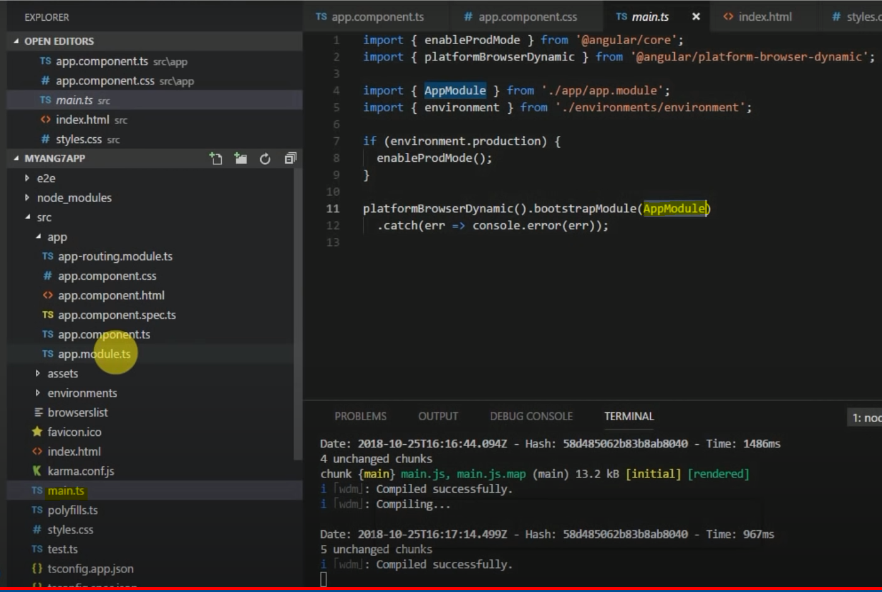
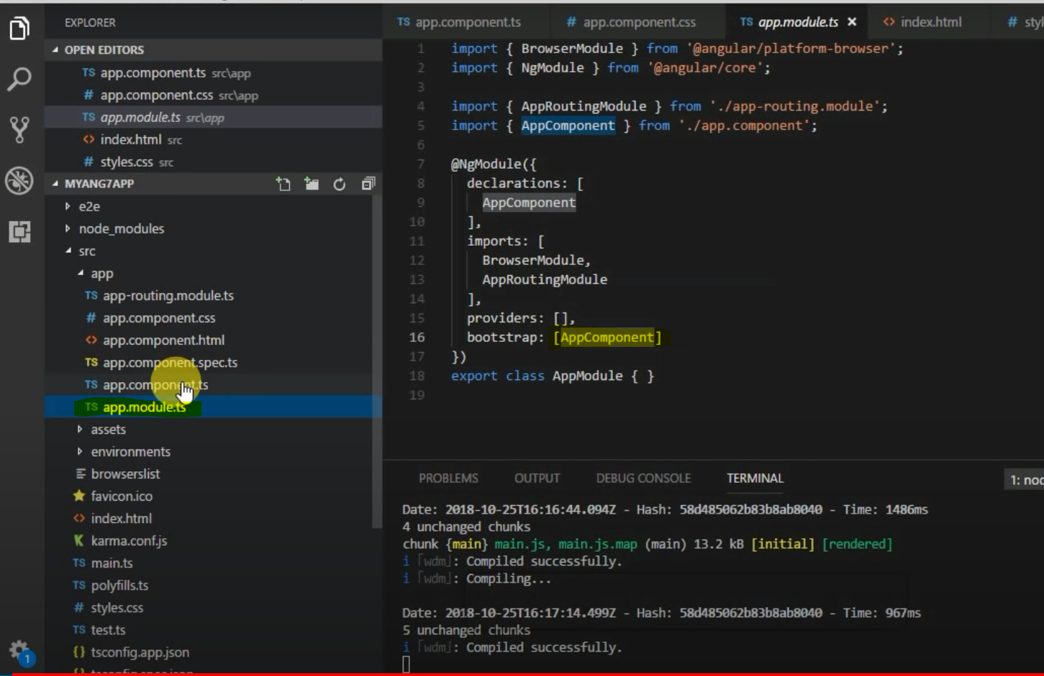
1. When Angular load the fist file is run is called main.ts
2. In main.ts there is written bootstrapModule(AppModule). It mean it refer to start app.module.ts first
3. And app.module.ts refer to AppComponent

Slide 18
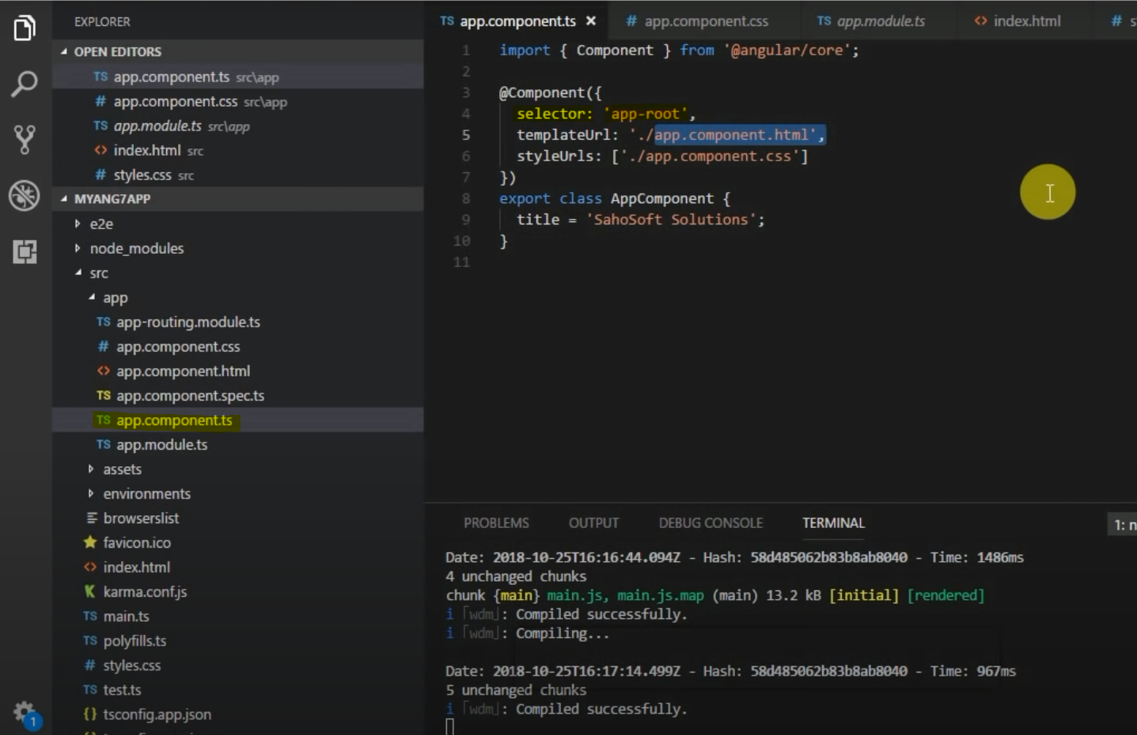
The following code accept any kind of type.
Property: any = {
“id”: 1,
“Property”:”House”,
“Price”:12000
}
To configure the git go to terminal and write
git config --global user.email “emailhere”
git config --globsl user.name “username”
-String interpolation is used to display the component property into html file. This is called oneway binding
-Property binding is being used to bind with the input parameter. You can use property binding to pass the data from
One component to other.

Slide 19
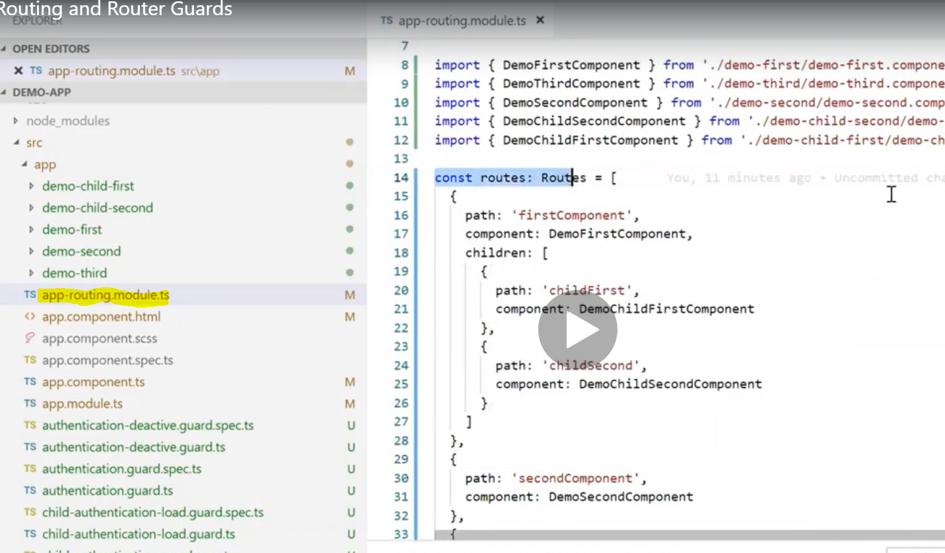
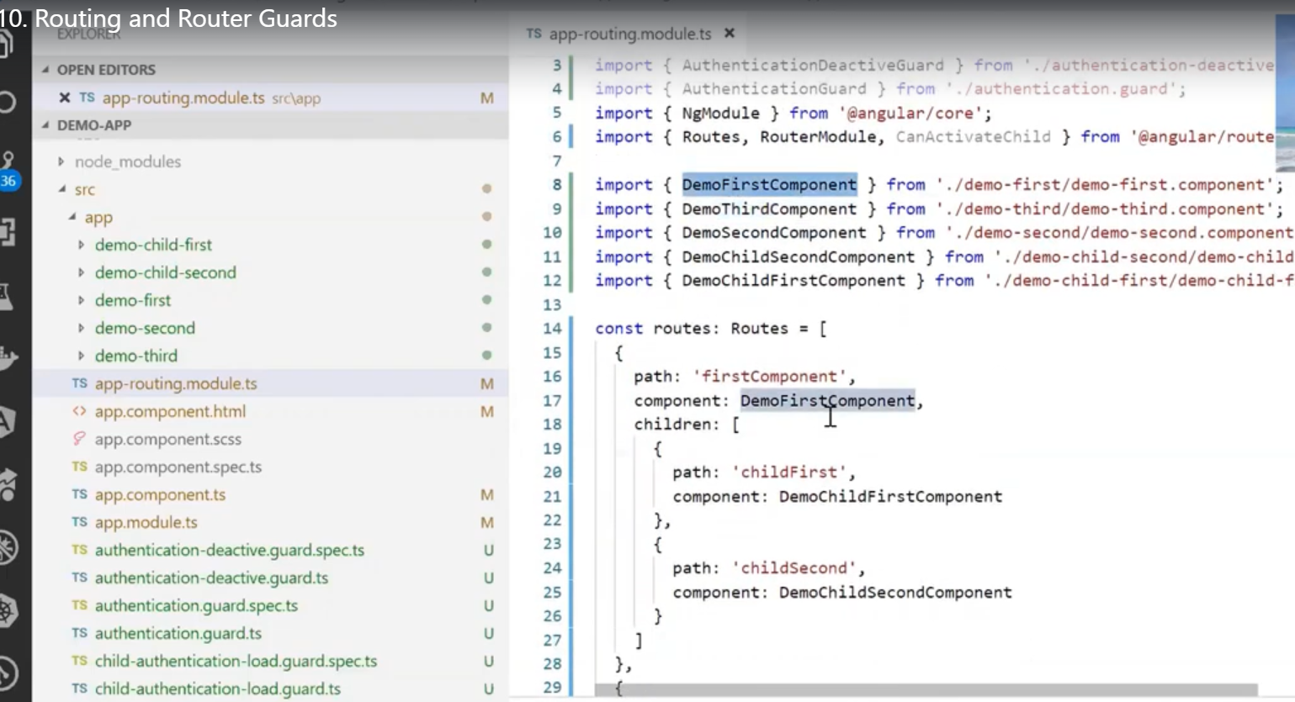
Routing
Child Routing
Gaurd
When you are creating the application, in the beginning the app will ask weather you want routing or not, if choose yes
Then only the app-routing-module will be created in our application

Slide 20
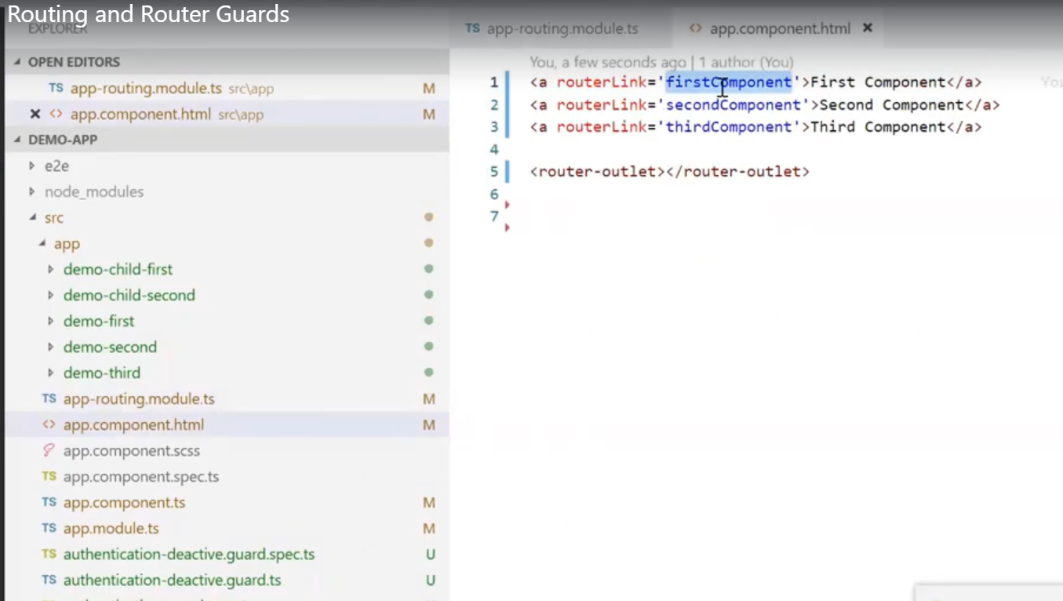
The following is the command to generate the component
ng g c first-component
As we have array of routing of routes for routing, we will define the same for child route in the routs to go for child. So there
Is child property will be used

Slide 21
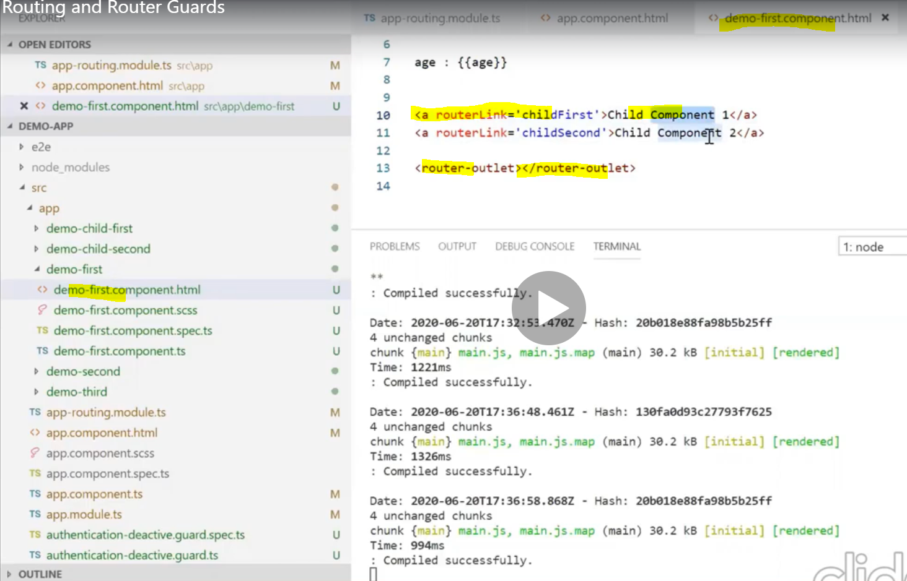

Slide 22
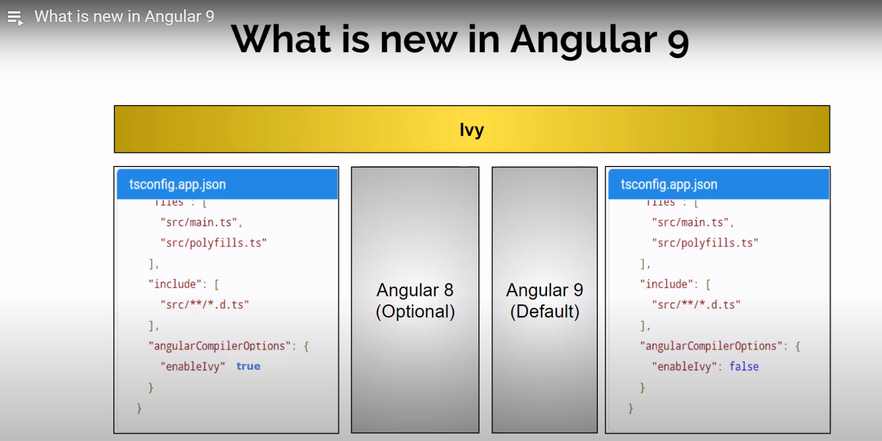
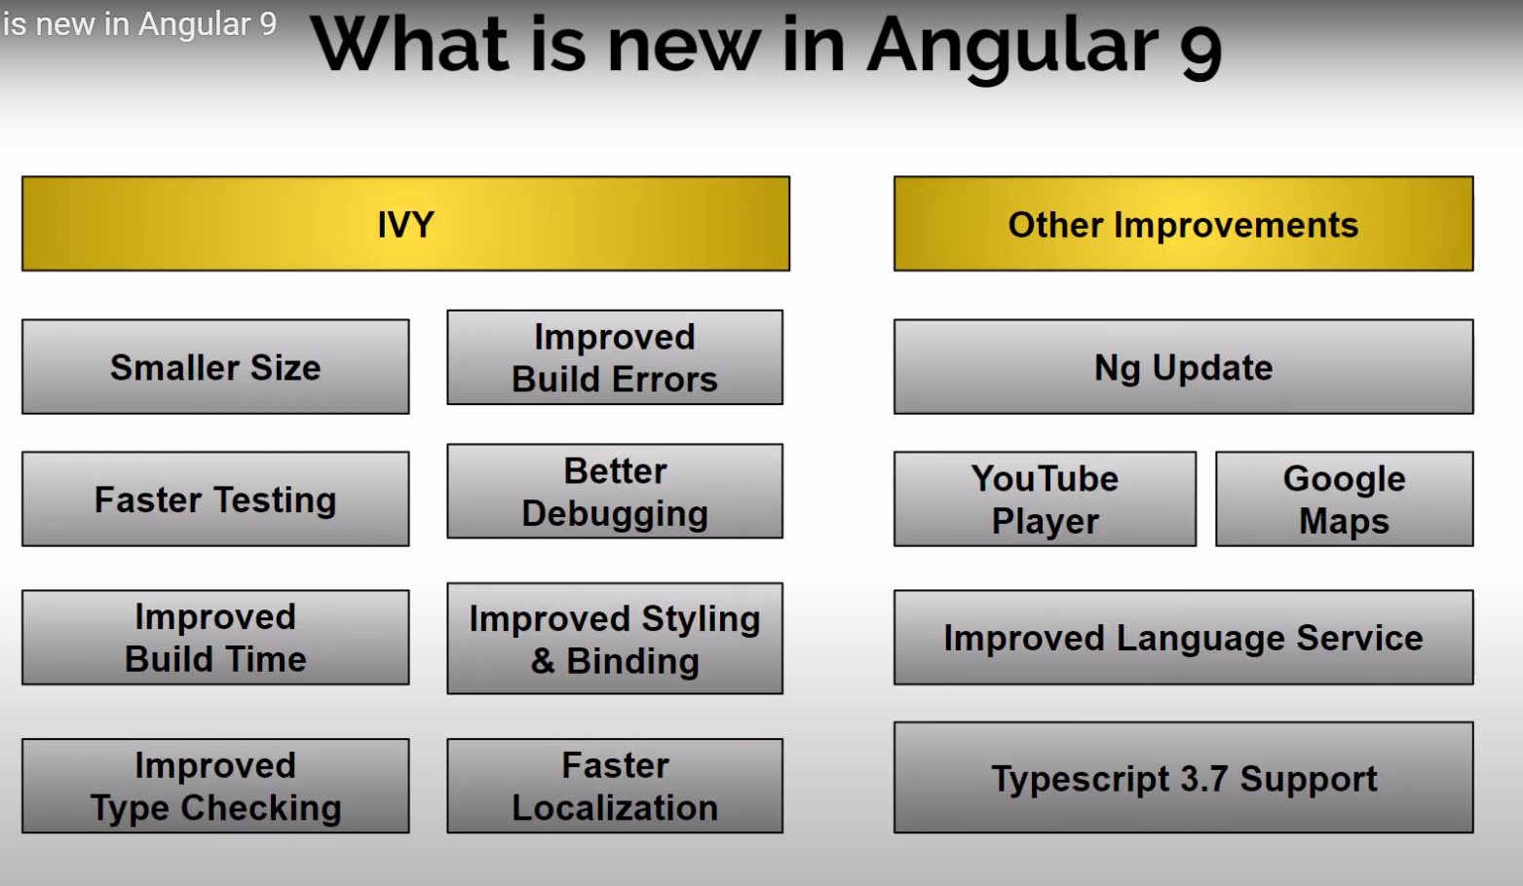
Angular 9 using Ivy as default compiler. Before it was optional.

Slide 23
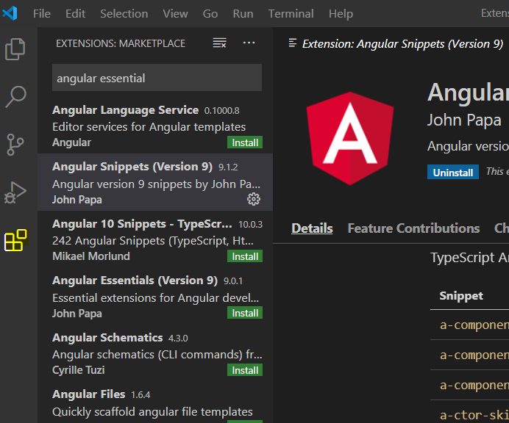
Vs code with some basic functionality, but we can install extension as we needed for what framework we are
Using. For instance for angular these following extension are very useful. You can install extension from the left side of
Icon, highlighted as yellow in the below screen shot
Write in the search like “angular essential”, then install Angular Snippets, Auto Rename Tag, Bracket Pair, Angular files.

Slide 24
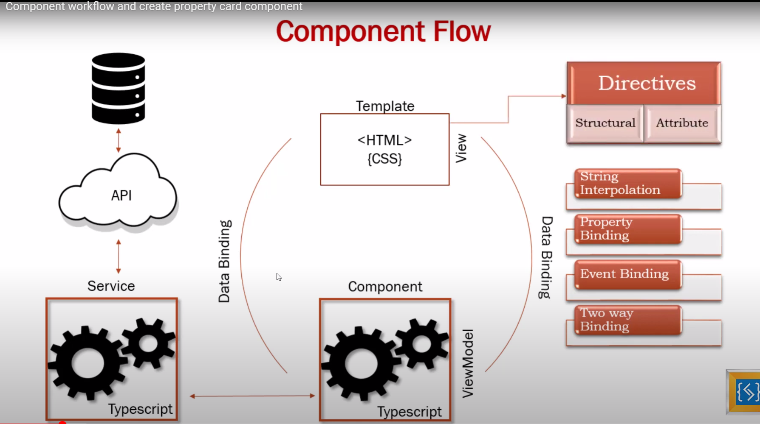

Slide 25
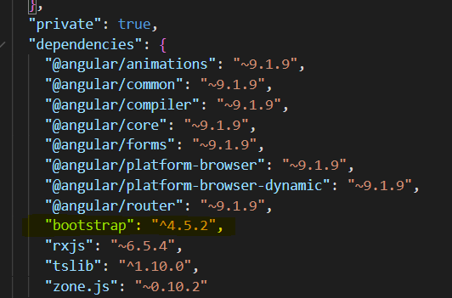
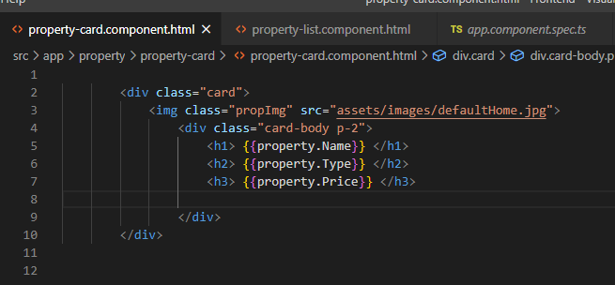
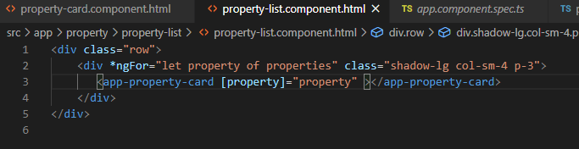
Install the bootstrap now, here the --save to insert the reference in package.json and then we add reference in the
Angular.json manually in style section as shown in the below screen shot
After install the boot strap we can use it in our project. The class of the bootstrap is row and card. That we are using in our project
On line 2 a loop is defined, for each property in
Properties in the div.
On line 3 [property]=“property” is the example of
String Interpolation

Slide 26
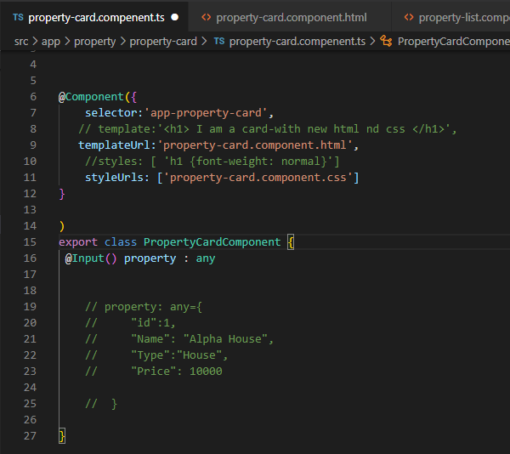
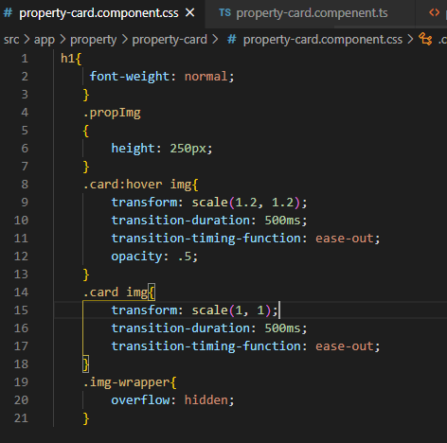
On line 16, define the input parameter of type any.
Type any mean, any kind of types can be exist.
.card-hover img{ …} class is defined to zoom-out the image
.car img {…} is beign defined to zoom-in the image

Slide 27
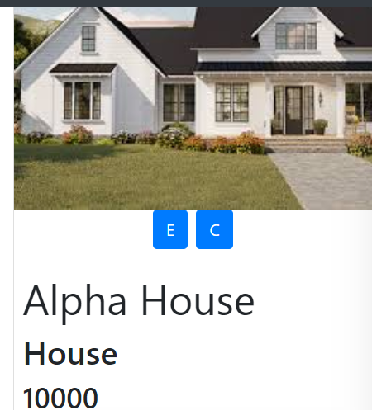
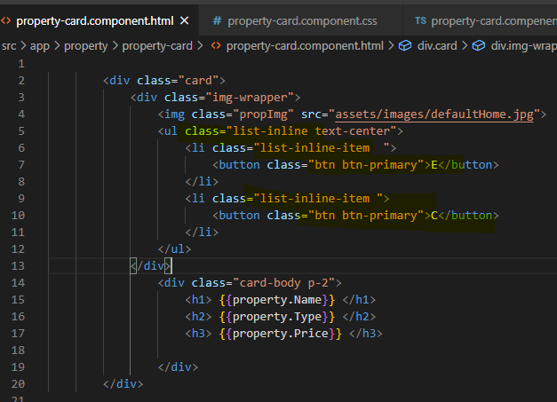
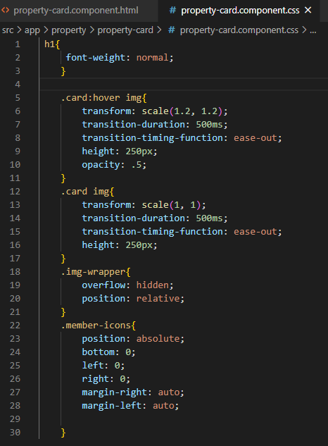
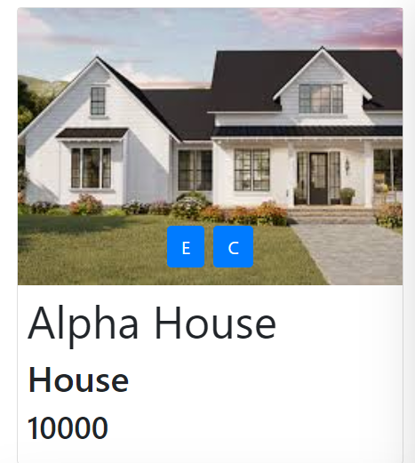
The left hand side button (E, C) are center and
Below the image is due to the css defined in the
Ul class=“list-inline-item” defined on the line
5 to 12.
To see the how the image come on the image
We need to add some more css, see in the next
picture
You can see we new class i.e member-icon
And finish the class propimg (you can see in the
Previous page) and height define with in the card
Class.
And now the button are now on the image
We will do a bit more change to hide button
And display only we hover the mouse on the
image

Slide 28
Font awesome web site is being used to add the icon and the E and C with Edit and contact icon’s class from fontawsome
Website.
To use the font awesome website icon paste the following under the <head> tag in index.html file
<script src="https://kit.fontawesome.com/b3f1e94de1.js" crossorigin="anonymous"></script>

Slide 29
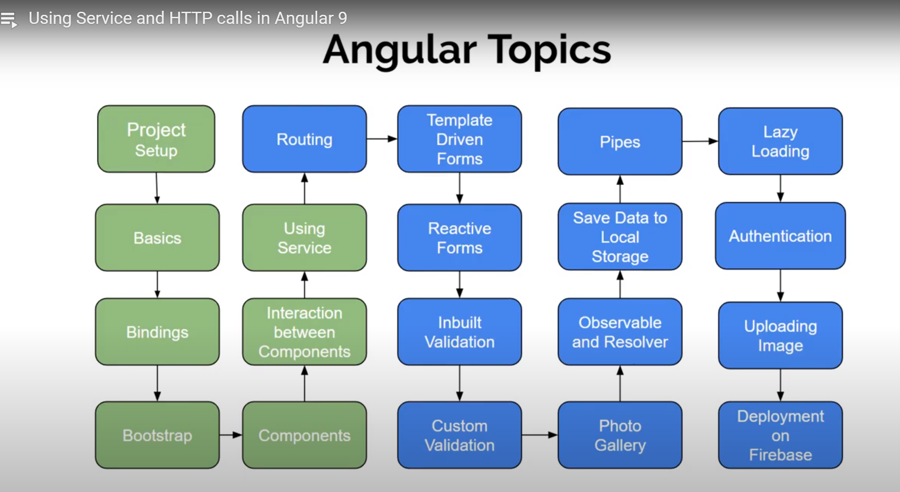

Slide 30
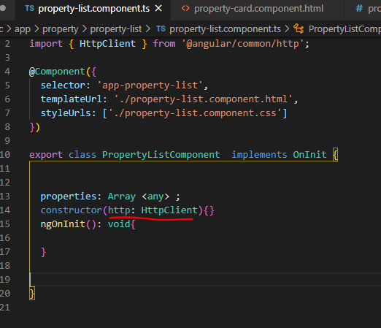
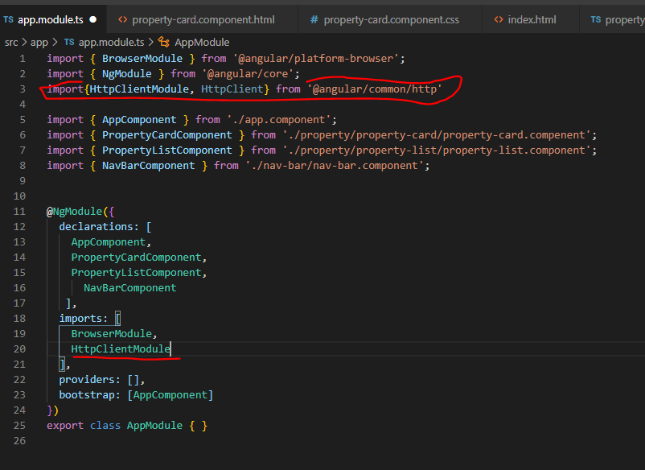
To use the http clinet module, we need to import
in app.module.ts file like below
And pass this to the constructor, like below

Slide 31
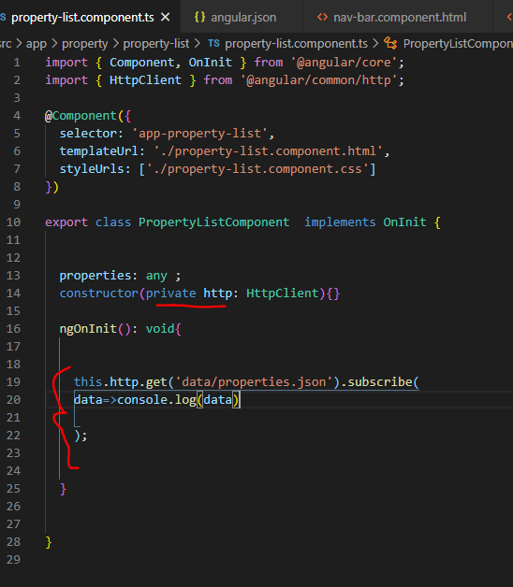
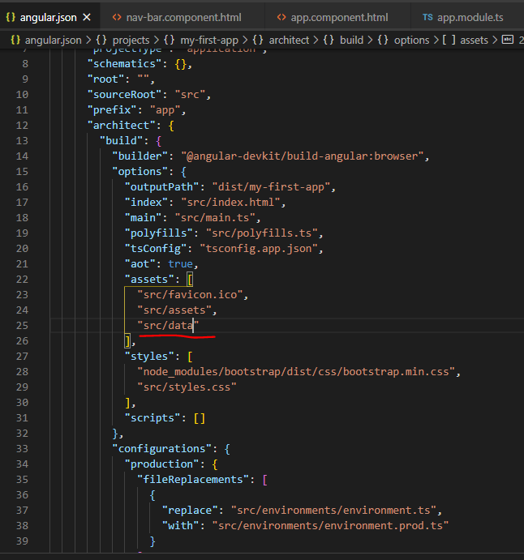
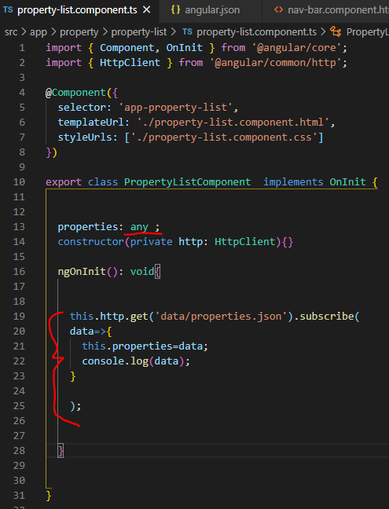
As we add new folder out side the app folder, so we need
to define it in the angular.json file as seen below

Slide 32
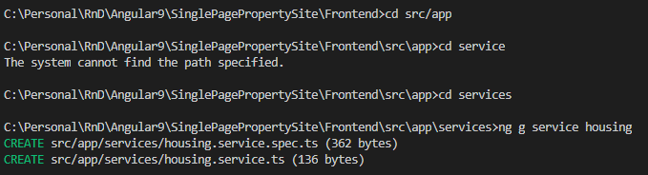
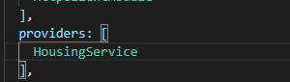
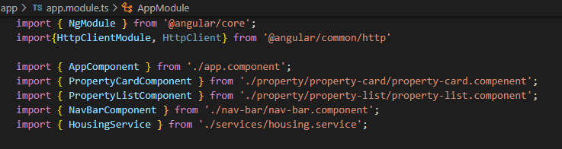
Create a folder under app folder with the name of services, an donterminal go to that new folder and then use the
Following command to create a service in the services folder
Ng g service housing
Here housing the service name
As soon as the service is created a file is created in the service folder with the name of housing.service.ts.
Now we have to register this service in app.module.ts under the providers. As soon as we register in the provider
Its imported, we can see in the next screen shot.

Slide 33
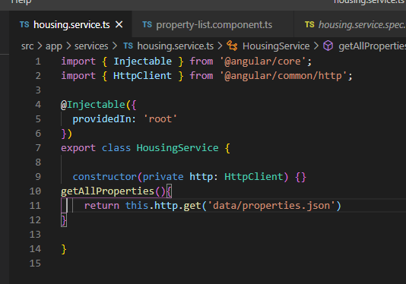
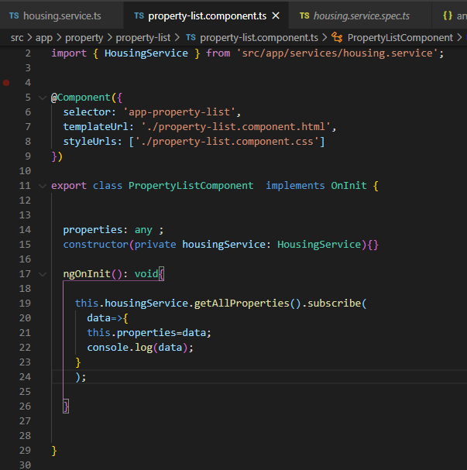

Slide 34
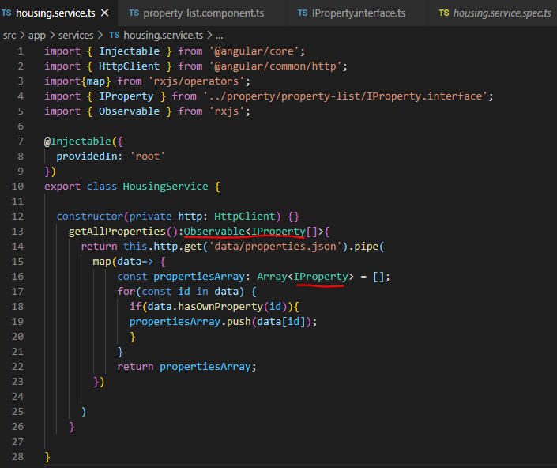
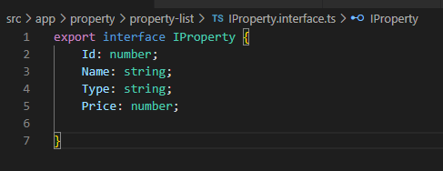
And wherever we have ‘any’ type will replace with ‘Iproperty’
Also change service file
What is observable and subscribe in angular
Define interface
Under the folder of property create a new file named
Iproperty.interface.ts And define the property
in this file like:

Slide 35
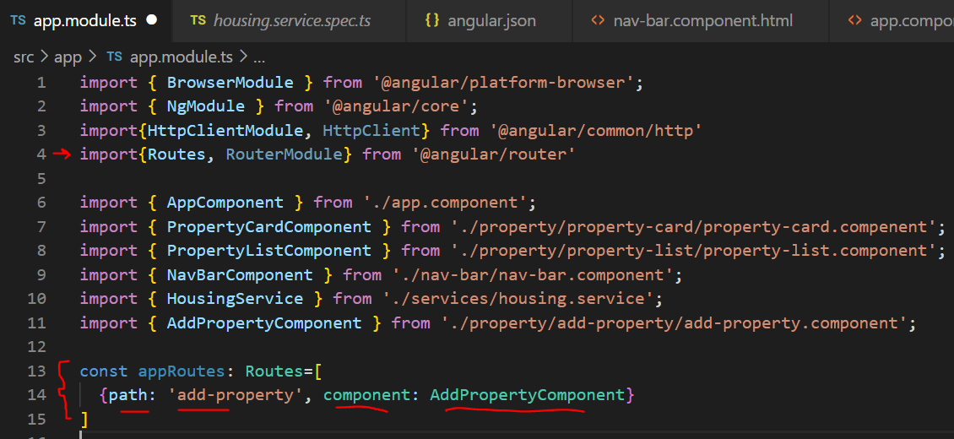
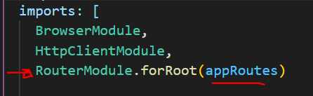
Routing
In Singlepage application we have index page, so every thing will load to this page, for this we need define routing.
For routing first need to import the following in app.module.ts
import{Routes, RouterModule} from '@angular/router'
And define a constant of type Routes and it is array in app.module.ts. And then define the path and component which is
Need to be load as shown in the figure. Finally we need to register this constant in the Imports Array
In the above figure ‘appRoutes’
Is the name of the constant which
We define in the left side figure.
By this way our app know route exist
But how we load dynamic page in
Our app

Slide 36
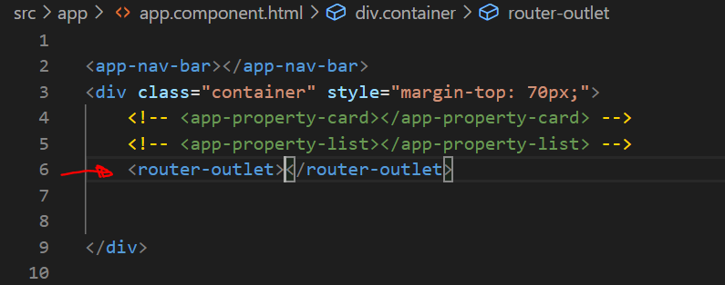


If you see, app.component is our root component that is loading, so we comment what we have earlier and
Add Router-outlet as shown in the figure below
And add component name of add-property in nav-bar
And add default component
propertyListComponent in app.module.
If path is empty like ‘ ‘, it mean
default

Slide 37


With the href, the once click on nav-bar, the complete page is re-loading all, this is what we don’t need. The content should change
And page should not load all. To achieve this, we should replace routerLink with href.
Add a back button and function OnBack

Slide 38


There are two different forms in Angular, 1) Template Driven Form and 2) reactive form. The template driven form
Code remain in HTML whereas Reactive form code remain in TS file. So the suggestion is either use Template or reactive
Through out in your application.
Let create a form using html:
The form is created, by simple html
And when we press submit, it will
Submit to server. But for angular we
need it Should convert to java script.
For this add the following in
app.module.ts

Slide 39





Import {FormModule} from ‘@angular/forms’;
And
In imports array add the following
FormModule,
And add ngSubmit on form tag in html file
And add same method in .Ts file

